Slide 1
Basics of Legal Environment and Court System
Bhadrakali Pokharel

Slide 2
Unit -1 Basics of Legal Environment and Court System 4-Lecture
Concept and Importance of Legal Environment
  Nature of law
  Types of Law
  Source of Law
Meaning and Source of Business law of Nepal
The Court System
  Structure, Powers, Organization and Jurisdiction of Court system
Provisions of Nepalese Constitution Pertaining to Business
Changing Dimensions of Nepalese Legal Environment

Slide 3
Background of Subject matter
Basically Law is known as set of rules.
Law is formal and informal social instrument.
At primitive stage of society, there were not any formal law.
Rules made by the member of society based on religious values. Which is known as Divine school of thoughts
Gradually, Various civilization was come in existent.
At 18th century, Jeremy Bentham introduced the concept of Greatest Happiness among the Greatest persons.
Then, different thoughts of Schools were Introduced.
Basic objectives of law is;
  To protect the personal liberty
  To protect the personal property
  To maintain peace and order in society
  To secure the Justice for all
Types of law can be divided by Subject, Object and Action.

Slide 4
General Meaning of Law
Law is a formal mechanism of social control. By changing nature of law there is not universal definition of law. It depends on the contexts and perceptions.
In general, the term 'law' means a set of rules. Those rules are made by the authorities. Public laws are made and implemented by sate authority. But private laws are imposed by the party in according to existing laws.
Lord Lloyd says "Since much juristic ink has flowed in an endeavor to provide a universally acceptable definition of law, but with little sign of attaining the objective".

Slide 5
Definition of Law
John Austin says: A law is a rule of conduct imposed and enforced by the sovereign.
According to Salmond: Law is the body of principles recognized and applied by the state of administration of Justice.
According to Justice Holms; Law is that what Justice says in his decision.
According to Roscoe Pound; Law is the body of principles, recognized or enforced by public and regular tribunals in the administration of Justice.
Lawrence, Robert and Peter; The law refers to the body of philosophy, principles, standards and rules which the Courts apply in deciding cases brought before them.

Slide 6
Cont...
Law denotes rules and Principles either enforced by an authority or self-imposed by the members of a society to regulate and control the people behaviour with a view to securing the justice, peaceful living and social security- M.C Kuchhal
The term 'LAW' can be defined as a set of principles, rules, regulations and usages which are made, recognized and enforced by supreme authority of the state and self imposed by the members of society for maintaining peace, order, harmonious relations and justice in the society.

Slide 7
Nature of Law
Nature means; Inborn quality, Inner quality, Distinguishes from others, It may be found in capability, objectives and characteristics.
  Law is the set of rules of conduct.
  Law is self imposed or enforced by state authority.
  Equal treatment, uniformity in action (Non-discrimination between all)
  Law is more powerful than the law-makers.
  Law derived from sovereign power.
  It should be based on reason and rationality.

Slide 8
Cont...
Law is not rights alone or might alone. But it is a perfect combination of them.
It is the tools of just and fair society.
Law is the tools of social integration.
Law is administered by the court.
It is backed by sanction of painful consequences incase of violation.
Ignorance of law is no excuse.
Aim of law is peaceful living, protection of Property and personal dignity.

Slide 9
Purpose of Law
To maintain the peace and security in society.
To maintain the social and political stability in the society.
To maintain the social solidarity and harmony in the society.
To contribute for strengthening the public welfare, national economy and individual and commercial interest.
To prohibit criminal activities and harmful human conduct in society.
Contribute to make developed, prosperous and civilized country in the international community.

Slide 10
Types of Law
  National Law
    Substantive law
    Procedural Law
  International Law
    Public International Law
    Private International Law
  Substantive Law
    Public law
    Private law
  Public law
    Criminal law
    Taxation law
  Private law
    Contract law, Family law
    Property law , Arbitration law

Slide 11
Cont...
National / State law
  National law deals the role of individual as well as society and state. All Nepalese laws are bundle of National Laws. National laws are called municipal. It governs within the national boundary. It is also call the territorial law. It regulates the people to people or people to state relations. National laws are also divided into various category.
International law
  International law is law of Nations, which deals relation and dispute raised between two or more than two parties. It creates rights and duties of State and International Institutions. International Treaties, Conventions are example of International Law. International law has divided into two category one is public International law and another is private international law.

Slide 12
Cont...
Substantive law:
  The substantive law is that part of law which deals about rights, duties and liabilities of people. It is main sources of rights, duties and obligation of person. Substantive law is based on the legal principles and subject matters.
Procedural law:
  Procedural law is belong with proceeding of legal matters. It governs the process of dispute settlement. It deals with how the content of law is implemented? It analyzes the process of remedy provided by substantive law. For example; Civil Procedural Code 2074
Civil law
  Civil law deals about rights, duties, status, position and property of person and group of persons. It does not include the criminal matter. Property, Family and Positional matters are regulated by civil law.

Slide 13
Cont...
Criminal law
  Criminal law defines the right or wrong and determines the crime and punishment in the system of law. It describes crime against individual, society, and state. It imposed the penalty and imprisonment guilty person and reparation for victims. Criminal law define the punishment up to life imprisonment on the gravity of crime.
Public Law
  Public law is concerning to public affairs or interests. It deals crime, punishment including national issues and concern. The constitution of the kingdom of Nepal is a best example of public law.
Private Law
  Private law is related with individual activities and interests. It creates position, claim, rights, property etc. Law of contract is an example of private law.

Slide 14
Source of Law
Source means a place from where something emerges, commence, come into existence of origin.
Source of law means origin authority and causes of existence of law.
Primary Sources
Legislation: (Enacted Laws by Parliament)
  Legislation is the main source of law in the modern states. It enjoys the law making power of country. It is made according to the change of time and it is the outcome of a long series of discussions among the representatives of people. It is made by legislative body and enforced by the supreme power.
Precedent: (Case law/ Produced by Court)
  Precedent is the judicial decision which contains itself principle. Such principle which creates in the verdict (decision) of apex court and is applicable to other similar future cases of the same nature of case.

Slide 15
Cont...
Ordinance and regulation: (By laws/ formulation by Executive)
  An executive body also makes laws in the name of the ordinance, order and regulations. It also fulfills the vacuum of law and is more useful to maintain day to day administrative functions of state. In absence of law and by deligated authority executive can enact the laws.
Custom and Usage: (Customary law)
  Custom is habitual behavioral system of the human society. It must be immemorial, reasonable, continuously observed certain and definite. Those custom, which are not oppose principles of morality and existing law, is called a valid custom in present and regarded as a source of law.
Convention: (Treaty making by parties)
  Convention means agreement between two or more parties for their dealings. Conventional law is derived form the convention and treaty and it is binding for concerned parties.

Slide 16
Cont...
Secondary Sources
Morals and equity:
  In the ancient period, there was not any distinction between law and morality. In the western countries, principle of equity had been exercised as morality. It is not concrete source of law however it encourages making law to fulfill the vacuum of law.
Opinion of experts:
  Opinions of the legal experts can also play vital role as secondary sources of law, which proved clear ideas for making law.
Foreign laws/ Research reports
  Foreign laws are reference matters of National laws. Research reports may play role to adopt the new laws to address the problems.

Slide 17
Scope of Business Law
Scope: area, limitation, domain, demarcation, field, Significance importance
"To extent of the area of subject matter that something deals with of to which it is relevant".
Business means activities of making, buying, selling and supplying of goods and services for money.
Business means;
  Commerce: Commerce means business between Country to country and cross boarder.
  Trade: The activities of buying and selling or exchanging goods or services between people to people and people to country.
  Industry: Industries denotes the meaning of production of goods from raw materials, especially in factories.

Slide 18
Cont...
Regulation, Control and Management of any Business organization.
Dealing rights, duties and obligations of business firm and Businessmen.
To Establishment, Operation, Development, Expansion and dissolution of any business organization.
To organize the Enterprises and Companies.
To develop the Industrial Sectors.
To develop the society.
To growth the economic Activities.
Effective development of business sectors.
To aware legal obligations of business firm and Businessmen.
To regulate, control and manage the Commerce, Trade and Industry.

Slide 19
Meaning of Business Law
According to A.K Sundran; Business law provides legitimacy, security, control and incentives to business activities. It also protects rights and interests of consumers or labors, and business and society.
M.C. Kuchhal sates; The term mercantile law may be defined as the branch of law which comprises laws concerning trade, industry and commerce.
Thus business law is that part of law which deals with all the laws connected with every activity of business and rights and obligations of business persons and business firms arising from the business transactions. It helps the business community to carry it's transactions without any fears and with certainty and confidence.

Slide 20
Features of Business Law
Business law is the fast growing part of law.
It regulates industry, trade and commerce.
It regulates every business activities of business community.
It includes the law of contract, company, agency, banking, insurance, arbitration.
It protects rights and interest of business community.
It is most important means to create positive environment for the prosperity of business.

Slide 21
Sources of Business Law
  Legislation (Law made by Parliament)
  Precedents (Law made by court)
  Ordinance ( Law made by Executive)
  Custom and Usages
  Commercial Treaties and Conventions
  English Mercantile Law
  Legal Writing and Experts Opinion

Slide 22
Importance of Business Law
To establish and run the business activities.
To increase and maintain business transactions.
To develop capital market. How to collect and how to use capital.
To develop the economic activities.
To prepare the foundation for national development.
To create employment and support the national interest.
To create the proper environment for investment.

Slide 23
Cont...
To regulate the behavior of businessmen and officials of the business sectors.
To develop the new principle of business.
To increase the knowledge of international business.
It helps to protect public health, safety and environment Protection.
To settle the commercial disputes.
To aware and caution to obligations and duties of businessmen and firms.

Slide 24
Court system
Court
  Courts are institutions established by law to solve legal dispute impartially after followed the procedures established by law
  Court means bench of Judges with authority to decide the dispute.
Court Structure
  Supreme Court
  High Court
  District court
  Specialized Court and Tribunals
Supreme Court
  Supreme court is apex Court of Nepali Court system. All judicial institutions are under the supervision of Supreme Court. Supreme Court Consists of one Chief Justice and 20 Justices.
Jurisdiction of Supreme Court
  Ordinary Jurisdiction
  Extra ordinary Jurisdiction
  Miscellaneous Jurisdiction

Slide 25
Court system...
Powers of Supreme Court
  To exercise original, appellate and writ jurisdiction
  To revision the decision of high court and other tribunals
  To hear the appeal of High court and others Tribunals
  To review the decision of supreme court itself
  To ultra vires the law which are contradictory with constitution
  To quash the decision of government which is against existing laws
  To interpret and protection the constitution and Public Interes and Litigation
  Decision and precedent of supreme court is binding for all.
Appointment of Justices
  Chief Justice appointed by President on recommendation of Constitutional Council and Justices of Supreme court appointed by Chief Justice on recommendation of Judicial Council.
Qualification of Justices
  At least three years work experience as Supreme Court Justice for Chief Justice and Five years work experience of high Court judge or 15 years experience as senior advocate and advocate or distinguished jurist or at least 12 years works experience of first class judicial officer

Slide 26
High Court
High Court is second tire of court structure of Nepal. Each state has one High Court and 11 Extended bench also established in various part of Nepal.
Jurisdiction of High Court
  Original Jurisdiction
  Appellate Jurisdiction
  Writ Jurisdiction
  Miscellaneous Jurisdiction
Powers of High Court
  To hear the appeal of verdict district court
  To receive the writs application
  To issues the order for court of contempt
  To Monitoring and Supervising the subordinated court
  Issues order in regarding to writ Petitions
  To change the decision of subordinated court

Slide 27
District Court
District Court
  District Court is first instance court. According to Section 3 of Judicial Administration Act 2073, there shall be one District Court, in each district and District Courts shall be located at the headquarters of Districts.
Jurisdiction of District court
  Original Jurisdiction
  Appellate Jurisdiction
  Writ Jurisdiction
Function and Powers of District Court
  To obtain the complaints
  To call the defendants
  To make statement of accused
  To collect the evidence
  To test the witness and other evidence
  To declare the guilt or innocent
  To execute the verdict of court

Slide 28
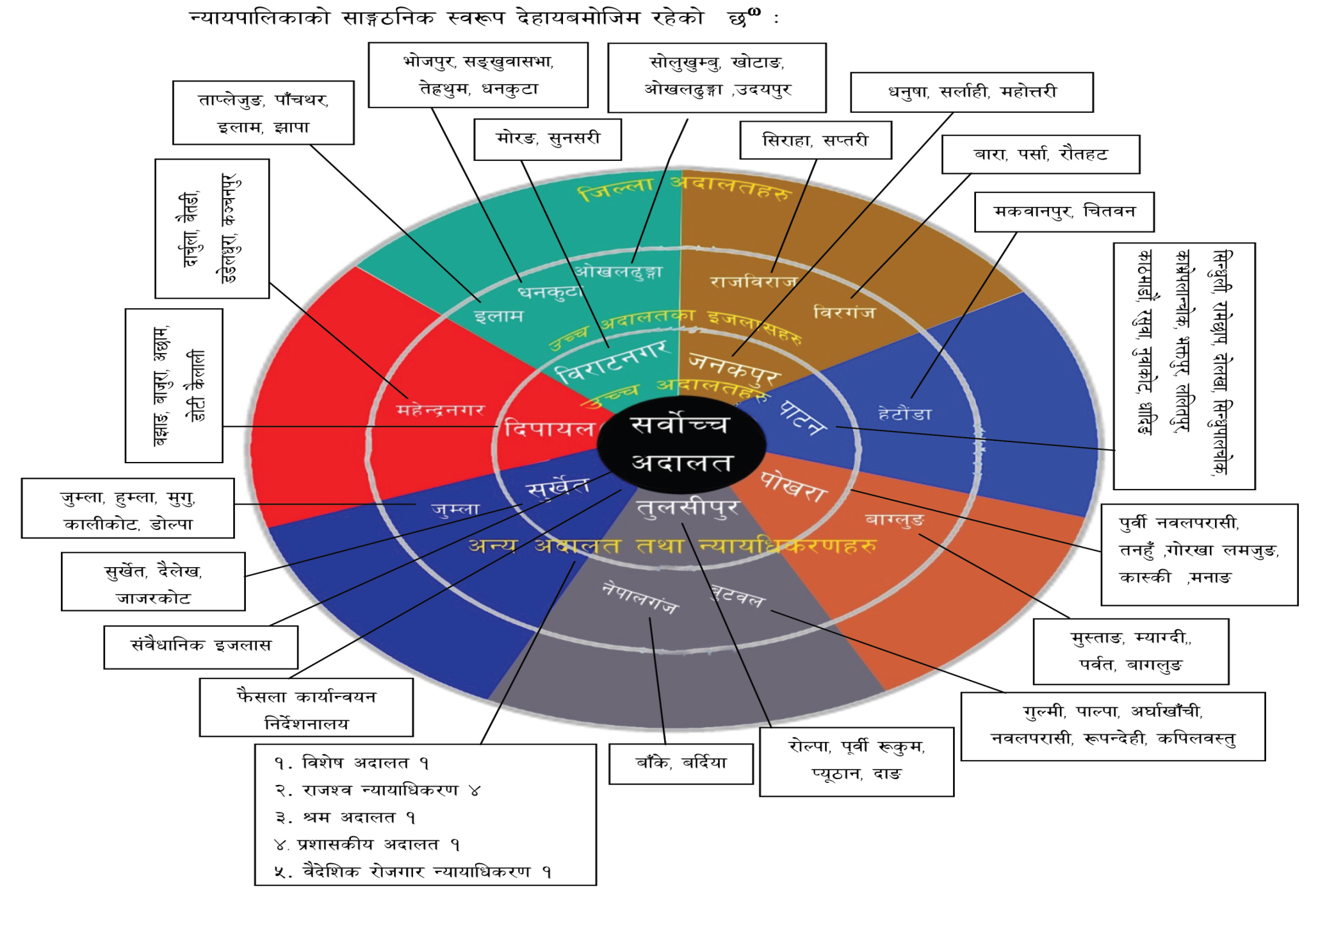
Nepali Court system

Slide 29
Civil Procedure
The process related civil matters is known civil procedure. Process is established by law for enforcement of civil laws is called the civil Procedure. It ensures the process to remedy for victim and punishment for accused.
Features
  It define the authority, process, time limitation to file the claim
  Prescribed jurisdiction to file suit.
  Determine the process to provide notice for defendant.
  Define the process for collection and examine of evident.
  To provide the opportunity for pleading the parties.
  To make Judgement of resolving the disputes.
  To ensure the right of appeal as per existing law.
  Execution of Judgement of Court.

Slide 30
Provisions of Nepalese Constitution Pertaining to Business
Right to freedom (Article 17)
  freedom to practice any profession, carry on any occupation, and establish and operate any industry, trade and business in any part of Nepal.
Policies relating to economy, industry and commerce (Article 51 (d) )
  To enhance national economy through participation and independent development of the public, private and cooperative sectors,
  To achieve economic prosperity by way of optimum mobilization the role of private sector in economy,
  To protect and promote domestic industries and priority to domestic investment based on Nepalese labour, skills and raw materials for the development of national economy,
  To give priority to domestic investment for the development of national economy,

Slide 31
Changing Dimensions of Nepalese Legal Environment
Situation created by law to regulate, control and manage the economic, social and political aspects in the country is called the legal environment.
Background
  We have not long written History of law
  First written law was Civil Code 1910 B.S
    Code has 163 chapter and 1400 pages. Out of 163 Chapter 57 Chapter were related with civil law
  Business Law is a part of Civil law: Under the chapter of Civil law; there are some legal provisions regarding to debt and bailment.
  New Civil Code, 2020 has some provisions relating to Contract.
  Before 1990 AD Nepal has adopted the State control economic policy.
  Government trading gold to salt.

Slide 32
Cont...
Changing Dimensions of Nepalese Legal Environment
  After the Political change of 1990 AD
  Nepal adopted the new economic policy: Privatization, Liberalization and Globalization
  Industrial Enterprise Act, 2049,
  Company Act, 2063
  General Civil Code 2074
  Arbitration Act, 2055
  Bank and Financial Act, 2063
  Foreign Direct Investment and Technology Transfer Act
  and others Regulations
  Technology and Trade, Commerce and Business.

Slide 33
Any queries
Thanks for your Active Participations

